Slide 1
House Price Prediction
By,
Anusha K

Slide 2
Introduction
Houses are one of the necessary needs of each and every person around the globe and therefore housing and real estate market is one of the markets which is one of the major contributors in the world’s economy.
A US-based housing company named Surprise Housing has decided to enter the Australian market. The company uses data analytics to purchase houses at a price below their actual values and flip them at a higher price. For the same purpose, the company has collected a data set from the sale of houses in Australia.
It is a very large market and there are various companies working in the domain. Some of the factors that are directly affect the house price are age of the house, location of the house, how many floors does the house have, water/electricity connections, Parking space availability, construction material, transportation, security and many more. Let’s analyse the data and build the predictive model to predict the price of a house.

Slide 3
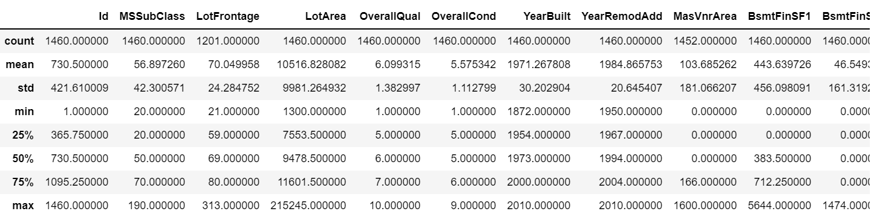
Statistical Summary of the Dataset
Statistical summary below shows the data skewness and the outliers in the dataset.

Slide 4
Data Preprocessing and Feature Engineering
Missing values are manipulated with appropriate values
Logarithmic Transformation for the skewness correction
LabelEncoder is used to encode the categorical variables
StandardScaler is used to bring the data to single scale
Feature selection using feature_selection.SelectFromModel library

Slide 5
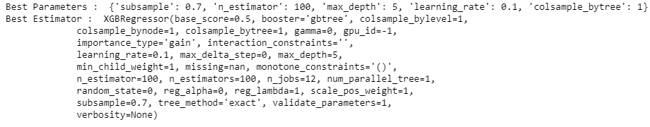
Model Building and Evaluation
Below are the algorithms used to predict the SalePrice in Model Building:
XGBoostRegressor
LassoRegression
RandomForestRegressor
DicisionTreeRegressor
Support Vector Machine
With XGBoostRegressor Hyper Parameter tuning and Cross Validation, the RMSE value was very minimal to 0.157. Hence we consider this algorithm for model building
The rmse value is : 0.1578674998167747

Slide 6
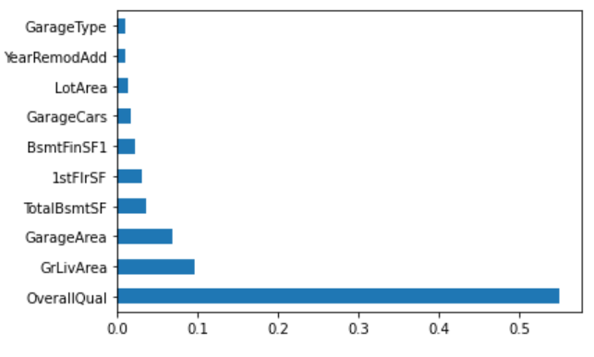
Conclusion
XGBoostRegressor is a powerful approach for building supervised regression models. The RMSE score obtailed by using this algorithm is 0.157
Below graph shows the important features that effects the house price directly.
OverallQual contributed the most towards the best accuracy followed by GrLivArea, GarageArea and TotalBsmtSF and so on.

